Slide 1
FAC114 Janitorial Services, Environmentally Preferable
Statewide Contract Vendor Overview
November 12, 2021, 10:00 – 11:30 a.m.

Slide 2


Webinar Logistics
Today’s presentation is being recorded.
Please keep webcams off and audio on mute.
Submit questions via the Chat feature.
We will forward a copy of this presentation and a link to today’s recording to all attendees.

Slide 3

Agenda
Procurated Ratings Platform
Eligible Entities
Use of COMMBUYS
Marketing Your Contract
Contract Reporting
Environmentally Preferable Products (EPP)
Business Updates
Training
Resources
Vendor Expectations
Supplier Diversity Program (SDP)
Q&A
Notes:
Today we will cover who is eligible to buy from Statewide Contracts, your use and responsibilities related to COMMBUYS, Supplier Diversity Program information and obligations, marketing your business, contract reporting, updating us about changes to your business, other ITT72 contract expectations, available training, and additional resources. I will allot time at the end for questions.

Slide 4

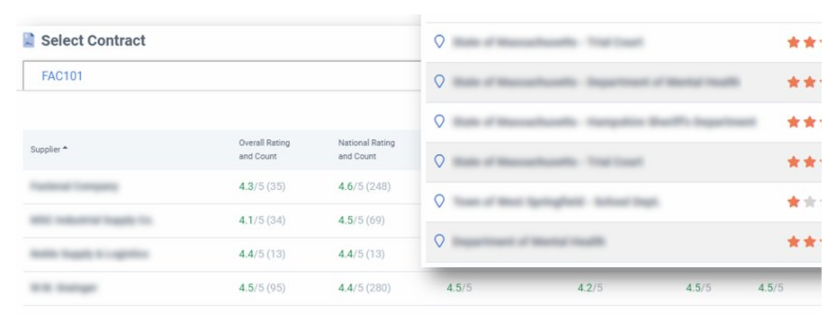
Because Every Decision Matters.™
Procurated is the nation's largest supplier ratings and reviews platform for the public sector.
Procurated users from over 2,000+ agencies have written 31,000+ reviews across 12,000+ different suppliers to date.
Massachusetts Procurated partnership started in the Fall of 2019.
  Contract Dashboards provide buyers with supplier performance data.
  Contract FAC114 – Janitorial Services, Environmentally Preferable.
Watch for emails and phone calls to gather performance data for suppliers on contract.
Request a log-in http://www.procurated.com

Slide 5
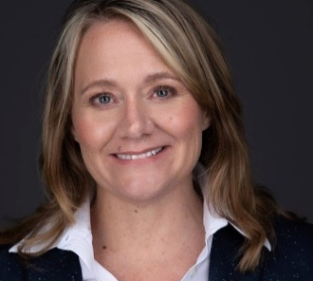
Because Every Decision Matters.™
Massachusetts Procurated partnership includes supplier education and outreach to assist suppliers to manage their performance.
Suppliers can participate in Procurated by claiming their page free of charge.
Watch for emails with links to webinars and training.
  Suppliers can claim their pages in the platform: https://www.procurated.com/suppliers
An optional introductory webinar will be scheduled, and invites will be sent following this session.
Ellen Sigl, Sr. Director, Community Engagement
Available for assistance for government users or suppliers: Ellen@Procurated.com
Request a log-in http://www.procurated.com

Slide 6

Congratulations on your Statewide Contract award!
Today’s session will introduce information and resources to help you fulfill your contract responsibilities and maximize business opportunities.
Notes:
Congratulations again on your Statewide Contract award!!!
Today we will review a series of resources to help you get acclimated to Statewide Contracting, information that will help you meet your contract obligations and maximize your contract’s business opportunity. I encourage you to share this information with all relevant staff.

Slide 7
Eligible Entities
Organizations eligible to use Statewide Contracts:
Cities, towns, districts, counties, and other political subdivisions |  | Public institutions of higher education
Executive, Legislative, and Judicial Branches, including all departments and elected offices therein |  | Public purchasing cooperatives
Independent public authorities, commissions, and quasi-public agencies |  | Non-profit, UFR-certified organizations that are doing business with the Commonwealth
Local public libraries, public school districts, and charter schools |  | Other states and territories with no prior approval by the State Purchasing Agent
Public hospitals owned by the Commonwealth of Massachusetts |  | Other entities when designated in writing by the State Purchasing Agent
Find this list on our website.
Notes:
A wide range of organization types are eligible to use Statewide Contracts, including executive departments, cities and towns, and public schools. Access this list on our website.

Slide 8

Use of COMMBUYS
SWC vendors are responsible for maintaining their COMMBUYS business profile. Use our Job Aids for updates.
Responding to buyer’s requests for quotes is a first step toward getting business and is a basic requirement of your agreed upon contract terms. Even if you do not intend to bid, vendors must respond to the request with a “no bid” by checking the “Is No Bid” checkbox on the General tab of your quote.
Vendors must log into COMMBUYS to access Purchase Orders and should acknowledge inbound orders: navigate to the bid using the Advanced Search and select “Yes” on the Acknowledge Receipt and View Solicitation window.
Notes:
It is critical that Statewide Contract vendors maintain their information in COMMBUYS. Seller Administrators are responsible for keeping their COMMBUYS business profile current, including address and email information, assigning Seller roles (staff who are able to respond to bid opportunities and receive Purchasing Order requests). Note that vendors are able to designate up to five email address for bid notifications. Also, because of the many important functions of the Seller Administrator, it is advisable to designate two COMMBUYS Seller Administrators.
Contractors are required to responding to buyers’ request for quotes. If you do not intend to bid, vendors still must enter a no bid response on the general tab of your quote in COMMBUYS.
Always acknowledge inbound purchase order requests. That process is documented here.

Slide 9

Use of COMMBUYS
Find your MBPO contract record in COMMBUYS:
    Select Advanced next to the top Search bar;
    From the dropdown, select Blankets;
    Enter FAC114 in the Description field and click the Search button.
    Attend the COMMBUYS for Awarded Statewide Contract Vendors class. Find information here.

Slide 10

Marketing Your Contract
Locate marketing lists on our Marketing Strategies page.
Sign up to attend the Selling to the State marketing class.
Use Statewide Contract and COMMBUYS logos on your website and marketing materials.
Forward marketing collateral for review by the Sourcing and OSD Marketing Units.
Notes:
The Commonwealth offers several resources to help vendors market their businesses. Visit our Marketing Strategies page for marketing lists and other guidance. Sign up to attend the Selling to the State – Marketing Your Business the Public Purchasers online class, and request and use the ITT72 and COMMBUYS logos on your website and marketing materials to promote your ITT72 contract. Marketing materials should be sent to me for review by the Sourcing and OSD marketing units.

Slide 11




Stay in Touch!
Interact with OSD on our social media channels:
Twitter: @Mass_OSD
Instagram: @Mass_OSD
LinkedIn: https://www.linkedin.com/company/ma-osd/
Blog: http://blog.mass.gov/osd/
Sign up to receive OSD communications. Share this link with your staff.
Notes:
We encourage you to stay in touch with OSD through our various social media channels. Also, sign up to receive OSD communications. Our bi-monthly magazine, Buy the Way, will provide a variety of agency updates of interest to buyers and our vendor community. Please do not unsubscribe as OSD will use this mailing list for other important vendor updates. Share this sign up link with your staff.

Slide 12

Contract Reporting
Statewide Contract Vendors have two distinct quarterly reporting requirements:
Sales details for the prior quarter (inclusive of SDP) are submitted through the Vendor Report Management (VRM) portal.
Administration Fee Reporting is submitted quarterly through the Administration Fee Online Portal.
Visit our Compliance with Statewide Contract Rules webpage.
Notes:
Statewide Contract Vendors have three distinct reporting obligations each quarter: Sales & SDP Data, EPP/EPEAT reporting and Administration Fee reporting. Sales data helps the Commonwealth measure contract and vendor performance. There are separate online locations to fulfill out Sales & SDP and Admin Fee quarterly reporting responsibilities. We will discuss each of these in more detail.

Slide 13

Contract Reporting Deadlines
Fiscal Quarter | Q1 | Q2 | Q3 | Q4
Calendar Quarter | Q3 | Q4 | Q1 | Q2
Quarter Period | Jul 1 – Sept 30 | Oct 1 – Dec 31 | Jan 1 – Mar 31 | Apr 1 – Jun 30
Report Due Date | Nov 15 | Feb 15 | May 15 | Aug 15
Notes:
Vendors should make note of these important reporting deadlines, but also will receive due date reminders from OSD.
If you have more than one contract with the Commonwealth of MA, you are required to separately submit sales data and admin fee reporting for each contract.

Slide 14
Contract Reporting - Sales
Use the Vendor Report Management (VRM) Portal to report sales information.
Find FAQs and VRM Job Aids on our website.
Update Business Contact Information in the VRM Portal.
Sign up for VRM Portal training at massosd.gob2g.com. Send questions about logging into the VRM portal to massosd@gob2g.com. For other inquiries, contact the OSDHelpDesk.
Locate the most current FAC114 Sales Template in the VRM Portal.
A $0 report is required even if you are reporting $0 in sales for the prior quarter.
Notes:
Vendors will use the Vendor Report Management or VRM portal to report sales information each quarter. Additionally, the portal is designed to send sales report updates to SWC vendors at key points during each reporting cycle. Vendors may designate up to two Business Contacts to receive these important messages. These business contacts may be any staff member who is set up as a User in the VRM portal. Vendors are encouraged to attend VRM portal training and to use the VRM resources posted on our website. Contact B2GNow, our portal provider with questions. Vendors also may contact the OSD Help Desk.
All contract related questions should be directed to the myself.

Slide 15

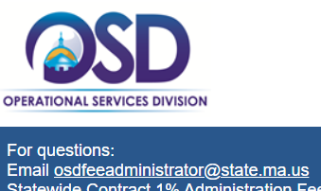
Contract Reporting – Administration Fee
The Administration Fee report summarizes total sales over the prior quarter and Statewide Contract Vendors remit the 1% Administration Fee using the Admin Fee Secure Online Portal.
Find FAQs on the OSD website.
Locate the Admin Fee Online Portal Job Aid.
Attend the Quarterly Report Overview webinar.
Contact the OSD Fee Administrator with questions.
A $0 report is required even if you are reporting $0 in sales for the prior quarter.
Notes:
The Administration Fee report, also submitted quarterly, is remitted through the Admin Fee Secure Online Portal. Our website provides FAQs and detailed job aid. Additionally, we offer a webinar that reviews this requirement. Please note that even on the occasion that vendors may not have sales for a particular quarter, vendors are required to submit a $0 report through the portal. Vendors should contact the OSD Fee Administrator with questions.

Slide 16
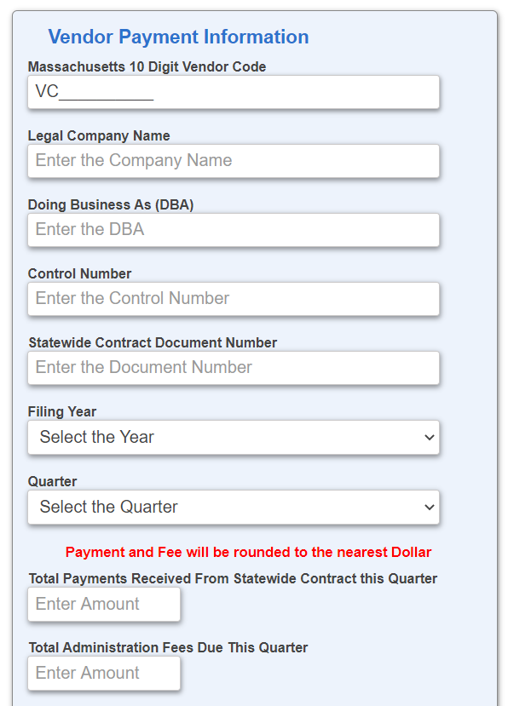
Contract Reporting – Administration Fee
Find your Vendor Code (VC) on the Standard Contract Form.
Control Numbers change each quarter. Use the number provided in the Admin Fee reminder email.
Enter FAC114.
Calculate 1% of the Total Payments.
Notes:
As part of the submission process, I want to stress that the Control Number, a required field in the Admin Fee Portal, is different each quarter. Staff that are designated to receive Admin Fee notices will be sent the Control Number to be used for that quarter.

Slide 17

Environmentally Preferable Products (EPP)
Provide EPP sales data as part of your VRM reporting, per the contract template;
Be familiar with OSD’s Environmentally Preferable Products and Services Guide;
Market your EPP products and services;
Contact OSD about EPPs requested by buyers that fit within the contract scope that you would like to add to your contract offerings during specified time in the RFR;
Institute policies that reduce your business’ environmental footprint.
All services as part of this contract are required to meet the service specifications found in Appendix 4: Service Specifications of the FAC114 RFR. Please refer to that document for additional guidance.

Slide 18
Environmentally Preferable Products (EPP) Continued
Cleaning Chemicals Training
  Vendor staff must be trained in the proper handling of chemicals, proper use and maintenance of cleaning equipment, and proper cleaning procedures.
  Such personnel must be familiar and experienced with product use, standard operating procedures, the proper sequencing of cleaning steps, and the proper use of personal protective equipment.
  Vendors and their staff must agree to attend training sessions as required, at a minimum annually, on green cleaning products to ensure that all staff are well versed on the proper use of these products, as well as new products and equipment that are introduced throughout the contract term.
Waste Materials Used During Cleaning
  Disposal of trash and any waste materials used while conducting the janitorial cleaning process is the sole responsibility of the vendor and should be in compliance with the Massachusetts Waste Disposal Ban Requirements.
    No extra surcharges or fees related to waste disposal will be allowed to be incurred by the eligible entity.

Slide 19

Business Updates
Keep OSD informed about changes to your business. These include:
Business Contract Manager information
Individuals reporting quarterly Sales Data or Administration Fees
Office location/remittance address
EFT account information
Company name or Tax ID number
Additions/deletions to Signatory Authorities.
Guidance is published on the Keep Your Company’s Information Current webpage.

Slide 20

Training
Review OSD’s online training classes, several for Statewide Contract Vendors:
COMMBUYS for Awarded Statewide Contract Vendors
Selling to the State – Marketing Your Business to Public Purchasers
Quarterly Report Overview: Administration Fee Reporting
Link to our complete Vendor Training Schedule.
Email the Training Department at OSDTraining@mass.gov.
Notes:
Training is a great way to get acclimated to Statewide Contracting and all of our classes are available online. Vendors should attend all the classes targeted to awarded Statewide Contract Vendors. View our class descriptions and link to the training schedule for available dates. Send an email to the training department if you have questions.

Slide 21
Resources
Contract User Guide – Covers how to purchase, awarded vendors, and other contract information. Find all Contract User Guides on our website.
VendorWeb – Maintained by the Office of the State Comptroller, the VendorWeb online database provides past and scheduled payments to your business from the Commonwealth of Massachusetts. For payment information from entities that fall outside of the Commonwealth’s payment system, contact the purchasing entity directly.
Notes:
The ITT72 Contract User Guide is a resource for buyers and vendors. It details how to purchase from the contract, the awarded vendors, and other contract information. Refer to our website for a copy.
VendorWeb is an online database that provides past and scheduled payments to vendors from the Commonwealth of Massachusetts. Log in to VendorWeb with your Vendor Code and the Last 4 digits of your business Tax ID#. For payments from eligible entities that fall outside of the Commonwealth’s payment system (cities and towns, public schools, non-profits etc.), contact the purchasing entity directly.

Slide 22
FAC114 Vendor Expectations
Green Cleaning Products Reminder
This contract requires the use of environmentally preferable, or “green” cleaning products by all awarded contractors as required by Executive Order 515 and specified in the RFR wherever they are available for the purpose of protecting human health and the environment to the greatest extent possible. Products used on this contract are required to meet the Statewide Contract FAC85 specifications (or any successor contract) or be listed on the FAC85 Approved Products List found in the FAC85 Master Contract Record (or any successor contract) in www.COMMBUYS.com.
Use of Masks
While conducting cleaning services onsite at customer locations, please ensure all staff comply with any local COVID-19 masking mandates.
  Masks are required indoors within the City of Boston, for example.

Slide 23
Executive Order 595
Updated COVID-19 Guidance
  As a general rule, Executive Order No. 595, Implementing a Requirement for COVID-19 Vaccination for the Commonwealth's Executive Department Employees, does not extend to vendor employees. However, vendor employees may be subject to a COVID-19 vaccination requirement in certain cases where those employees regularly perform work on-site alongside Commonwealth employees or where those vendor employees provide direct service to members of the public on behalf of a Commonwealth agency.
  Vendors should contact their user agency for additional information. User agencies with questions should contact the General Counsel of their Secretariat.

Slide 24
Dmitriy Nikolayev
Director of Programs, Policy, and Reporting
Notes:
Thank you so much for having us. The Supplier Diversity Office (the SDO) is the Commonwealth’s newest executive agency coordinating several programs that work to ensure that divers and small businesses have a fair chance of participating in the Commonwealth’s contracts. Congratulations on being awarded a statewide contract! I am sure you remember that you were required to commit a percentage of your contract revenue to spending with certified diverse businesses under the Supplier Diversity Program (SDP). Now that you have been awarded a contract, I would like to discuss what is required of you as a contractor to maintain your compliance with the terms of the program throughout the life of this contract.
NEXT SLIDE

Slide 25

What is Supplier Diversity?
Supplier diversity is…
the business practice of consistently including diverse businesses in an organization’s procurement activities.
an important part of the Commonwealth’s definition of “best value” in procurement.
distinct from workforce diversity.
Notes:
First, let’s discuss what we mean by “supplier diversity.” We define supplier diversity as the business practice of consistently including diverse businesses in an organization’s procurement activities.
The key words for us are:
“consistently” – because this practice is only effective if it is a consistent business practice with a responsible individual or unit, more on that later – and
“businesses” – because supplier diversity is different from workforce diversity. Workforce diversity has to do with hiring, promotion and retention of diverse individuals, and supplier diversity relates to how your company engages other companies and organizations in business-to-business relationships.
The ability to incorporate supplier diversity into contract performance and overall operations is a significant component of the value the Commonwealth expects from its contractors.
NEXT SLIDE

Slide 26
What is the Supplier Diversity Program (SDP)?
Mission
To promote equality and diversity in state contracting.
How it works
Executive state agencies must meet annual goals for spending with certified diverse businesses.
These goals may be met through:
Direct
Spending
Certified
State Agency
$
Prime Contractor
Indirect
Spending
Certified
State Agency
$
Prime Contractor
$
SDP
Partner
To facilitate indirect spending, SDP Partnerships are required for all non-construction Executive Agency procurements expected to result in spending more than $250,000 per year.
Notes:
The mission of the supplier diversity program is to promote equality and diversity in state contracting.
The way it works is that, on an annual basis, the Supplier Diversity Office sets spending goals for departments, which require them to engage diverse and small businesses in their operations.
These goals can be met by:
Directly contracting with certified diverse contractors – contractors that are themselves certified in the minority, woman, veteran and other diverse business categories. If your company is certified, you should use your certification as a marketing tool to encourage agencies to do business with you.
In addition, agencies can meet their spending goals through indirect spending. This is the type of spending where the agencies’ prime contractors engage certified diverse subcontractors and other business partners and then report how much they spent through those partnerships back to the agency. We call that indirect spending.
To facilitate this indirect spending, SDP partnerships are required for all non-construction contracts by executive agencies where an agency expects to spend more than $250K a year. This requirement applies to all vendors on this contract.
NEXT SLIDE

Slide 27

Key Contract Requirements
  All
  Bidders proposed a % of their contract sales to be spent with certified diverse companies (SDP Partners).
  Contractors must report spending with SDP Partner(s) for the duration of the contract.
  SDP Partners utilized by Contractors must be listed in one of the two directories identified in this presentation.
The SDP requirements apply even if your company:
  Expects to do less than $250,000 per year in business.
  Does not have SDP Partners at the moment.
  Is a certified diverse business.
!
Notes:
(All new)
What does this mean in practice? The program has three key requirements that all contractors without exception:
You are on contract because you have met the first one – you proposed a % of your company’s contract sales to be spent with certified diverse companies.
We call the percentage your “SDP Commitment” and
We call the certified diverse companies “SDP Partners.”
Now that you are awarded, all contractors must report spending with SDP Partner(s) on a quarterly basis for the duration of the contract.
Finally, all SDP Partners utilized by Contractors must be listed in one of the two directories identified in this presentation.
These requirements apply to your company even if:
Even if your company, individually, does not make a significant amount of money from the contract,
Even if your company does not have SDP Partners at the moment, and
Even if your company itself is a certified diverse company.
That is correct: even if your company is itself certified as a diverse business, you are still required to contract with a different diverse business to meet the requirements of this bid.
NEXT SLIDE

Slide 28
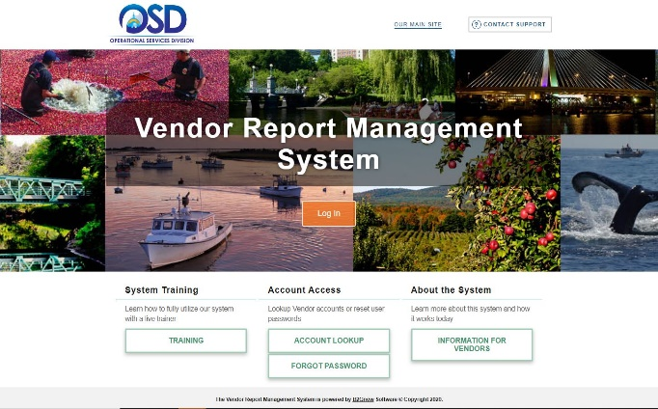
Supplier Diversity Program Plan Forms
When Bidding
When Reporting
Bidders pledge a % of sales to be spent with SDP Partners and describe current supplier diversity efforts.
On a quarterly basis, contractors report amounts spent with SDP Partners.
Notes:
(All new)
As you remember, at the time of bid, you submitted a completed SDP Plan Form. On this form, you:
Described the “consistent practice” of inclusion of SDP partners into your business operations.
Stated your total SDP Percentage Commitment to be spent with certified diverse partners.
Proposed a list of SDP Partners you plan to use.
The goal of the planning process was to make sure that the Commonwealth selects not just a company with the most competitive SDP Plan, but one that is most likely to meet it.
To demonstrate that you are delivering on your commitment, the Commonwealth expects all vendors on this contract to file quarterly spending reports showing expenditures with proposed (and any new) SDP Partners. OSD’s Vendor Report Management system is used for filing both sales and SDP reports.
To make sure your reports meet all the program requirements, I want to go through the requirements once again.
NEXT SLIDE

Slide 29
Eligible Partner Certifications
Categories | Meaning . . .
MBE M/NPO | Minority Business Enterprise Minority Non-Profit Organization
WBE W/NPO | Woman Business Enterprise Women Non-Profit Organization
VBE SDVOBE | Veteran Business Enterprise Service-Disabled Veteran-Owned Business Enterprise
DOBE | Disability-Owned Business Enterprise
LGBTBE | Lesbian, Gay, Bisexual, Transgender Business Enterprise
Eligible
for SDP
Not Eligible
for SDP
DBE | Disadvantaged Business Enterprise
PBE | Portuguese Business Enterprise
Notes:
(Shortened)
I have mentioned that only specific categories of diverse companies are eligible to be your SDP partners. Those are:
Minority Business Enterprises and Nonprofit Organizations
Women Business Enterprises and Nonprofit Organizations
Veteran and Service-Disabled Veteran-Owned Businesses
Disability Owned Businesses, and
LGBT Owned Businesses
Two certification types you are likely to encounter that are valuable but do not contribute to meeting your supplier diversity commitment are:
DBE, or Disadvantaged Business Enterprise, which is a federal certification category relevant for federally-funded construction projects, and
PBE, or Portuguese Business Enterprise, which is a category only relevant for certain state funded highway projects.
Remember these when you evaluate potential supplier diversity partners. Also, if your company is itself certified in one or more of these categories, just like any other bidder, you will still be required to find a different, unrelated diverse company to serve as your SDP partner.
NEXT SLIDE

Slide 30
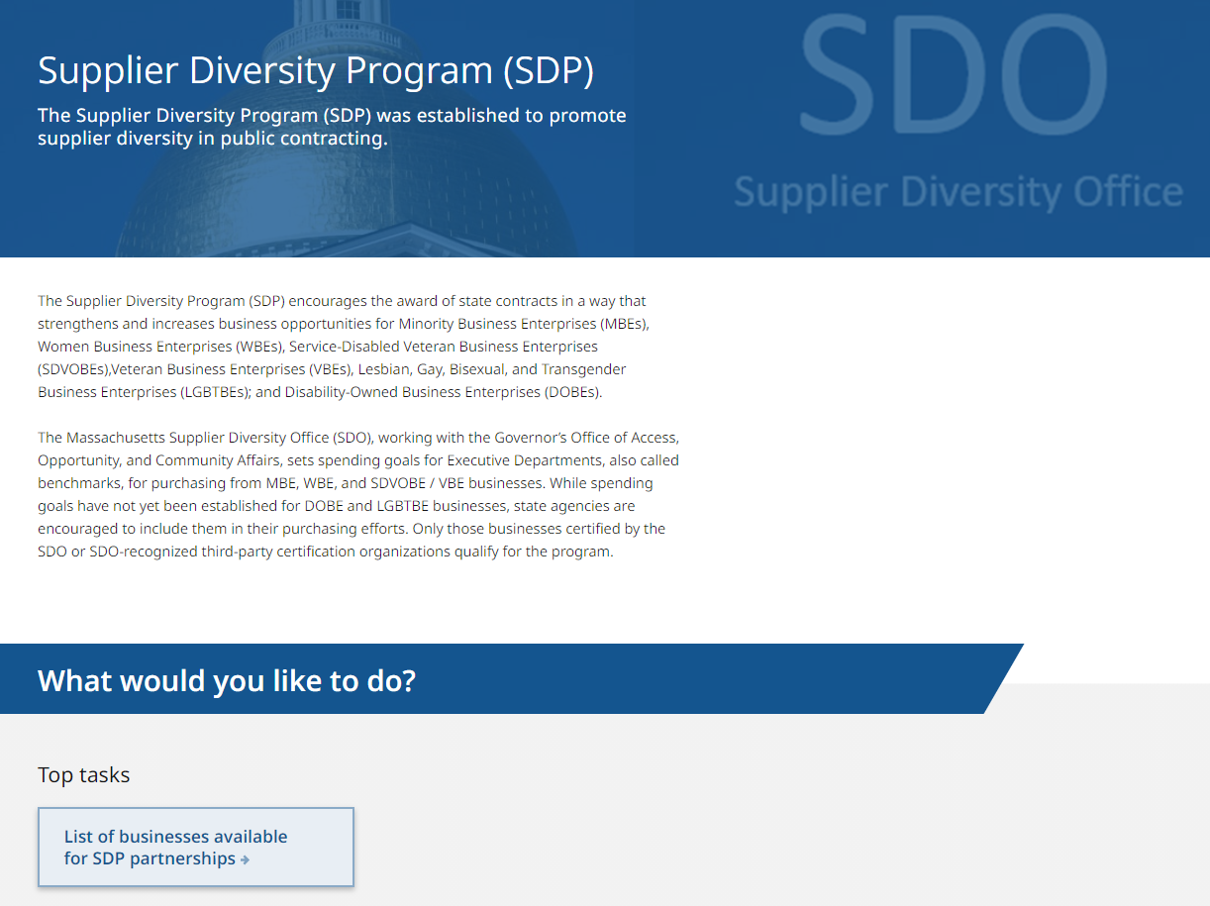
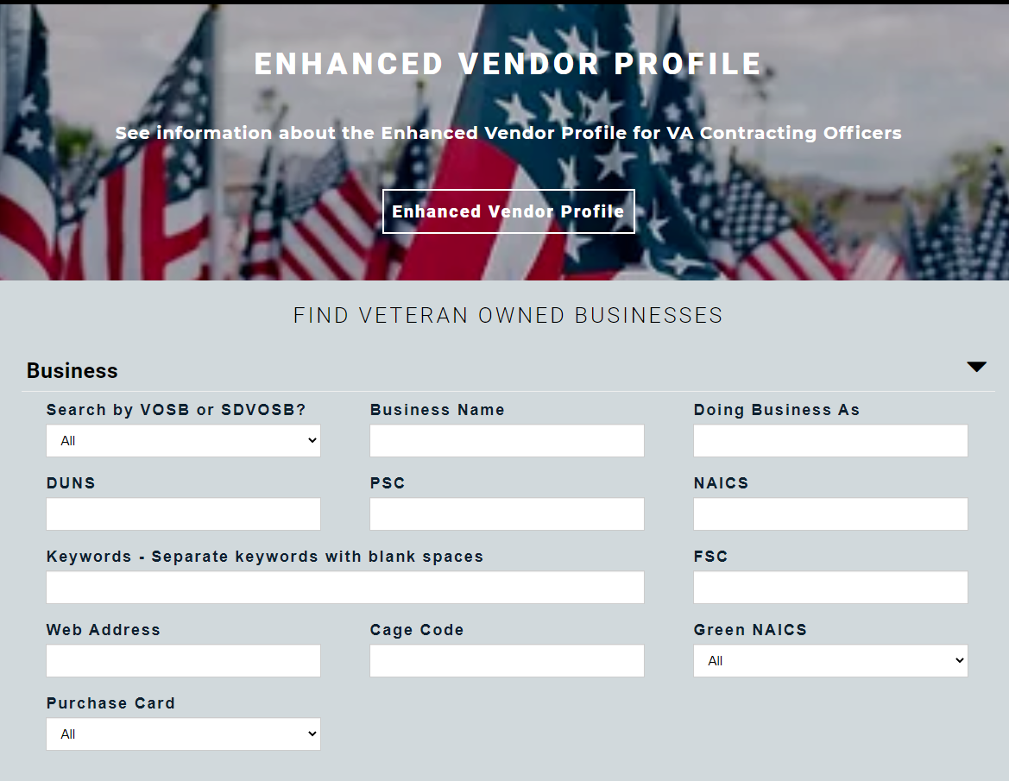
Online Directories of Certified Businesses
Check if your SDP Partner is certified or find a new SDP Partner:
The SDO Directory of Certified Businesses
More than 3,700 certified businesses
MBE, WBE, VBE, SDVOBE, DOBE, LGBTBE
www.mass.gov/sdp
The U.S. Veterans Administration
Vendor Information Pages (VIP)
More than 14,000 certified businesses
VOSB, SDVOSB
https://vetbiz.va.gov/basic-search/
If you cannot find your existing or proposed SDP partner in these directories, connect them with the SDO at sdp@mass.gov to discuss certification.
!
Notes:
(All new)
While there are many organizations that certify companies in the eligible categories I just mentioned, the only companies that qualify for your reports are those certified or recognized by the SDO. The easiest way to check if your existing SDP partner meets this standard – or to find a new SDP partner – is to use these two directories:
The Supplier Diversity Office maintains the SDO Directory of Certified Businesses. The directory is available on the SDO website and contains more than 3,700 certified businesses in the categories I mentioned earlier, some certified by the SDO and some certified by organizations whose certifications the SDO recognizes. This is the directory where you may also encounter companies who are not eligible. For example, companies that only have the federal DBE or ACDBE certification or the state Portuguese Business Enterprise certification and no other certification that is eligible for SDP cannot serve as your SDP partners.
The second directory of available partners is the Vendor Information Pages maintained by the U.S. Veterans Administration. This directory contains more than 14,000 companies nationwide that are certified as Veteran-Owned and Service-Disabled Veteran-Owned Small Businesses. While the certification categories are worded slightly differently from our state categories, all of the businesses in that directory are eligible to be SDP partners.
What if you cannot find your current or proposed SDP partner in these directories?
It is possible that they have not been certified or recognized by the SDO.
It is also possible that their certification has expired – certifications are valid for one to three years depending on the certifying body.
In either case, put the partner in touch with the SDO by emailing sdp@mass.gov. Stay in touch with the partner to ensure they go through all the required steps to apply for certification or recognition based on the SDO’s guidance – or to renew their certification. It is your responsibility as a contractor to ensure the partner completes the necessary steps.
NEXT SLIDE

Slide 31



Program Flexibility
  Your SDP Partner…
  Does not have to be a subcontractor
  May be located outside of Massachusetts
  May be changed at any time
One-time and occasional purchases also qualify
(e.g. business cards, office equipment, fire extinguisher testing, etc.)
!
Notes:
While the SDP is very specific about what types of businesses are eligible to be your SDP partners, it is very flexible as to how you engage them:
First of all, your SDP partner does not need to be a subcontractor. You may engage diverse businesses to meet your general business needs.
Your SDP partners do not have to be located in Massachusetts. When you search the SDO certification directory, you will see that we certify and recognize businesses nationwide.
Your relationship with your SDP partner does not need to be long-term. Just like any business-to-business relationship, this can be long-term, short-term, occasional or even incidental.
One-time purchases, such as business cards, office equipment or fire extinguisher testing, also qualify.
The key requirements still apply though:
Your partners be SDO-certified or recognized, and
Your spending with all these partners at the end of the fiscal year must be equal to or more than your SDP commitment.
NEXT SLIDE

Slide 32



Partnership Options
Subcontracting
SDP Partners may assist the contractor in providing goods and services offered on contract.
  Manufacturing/supplying a product for resale
  e.g., printing calendars for sale as office supplies, food products for sale by a grocery vendor
  Supplying a process/component for the prime contractor’s product/service
  e.g., outsourced logistics services, die cutting or binding services outsourced by a printing company, supplying electronic components for a product manufacturer
  Providing a portion of a scope of service
    e.g., providing a portion of state-funded consulting, engineering or IT project
Notes:
In addition to naming the SDP partners with which you had spending in a given quarter, you will be asked to classify your business-to-business relationship with them as one of two types of relationships: subcontracting or ancillary products and services.
Let’s start with subcontracting. This is the type of business relationship where the certified diverse partner assists your company in providing goods and services offered on contract. It can be providing a product or service for resale, providing a process or a component for a product or service you sell, or actually providing a portion of a scope of service on a contract.
NEXT SLIDE

Slide 33







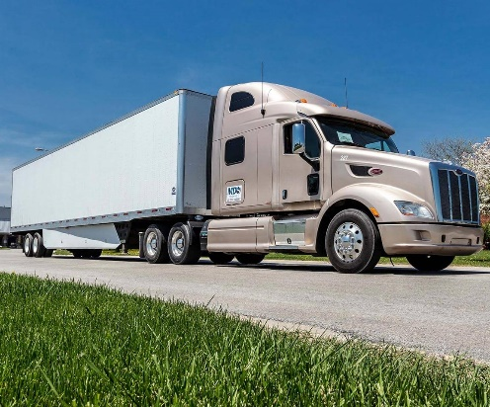

Partnership Options
Ancillary Products or Services/General Business Needs
SDP Partners may supply products or services needed for the contractor’s general business operations.
Notes:
I have also mentioned the “ancillary product or service” relationship. This is the type of relationship where the SDP partner supplies products or services for your general business operations. Examples include:
Book keeping and accounting,
IT services,
Administrative and clerical services,
Construction and trade services,
Landscaping, and
Transportation.
These are some of the most popular partnership types we see, but directories of certified businesses I will show you include a potential partner for virtually any need. And if you can’t find a partner just by searching, you can always email some of the companies to see if they offer the product or service that you need.
NEXT SLIDE

Slide 34

Finding Eligible Certified Partners
1
Find current suppliers that are certified
Download the lists of eligible SDP partners from the SDO and VetBiz directories and compare your current suppliers to those lists.
2
Find current suppliers that may be certified
Survey your suppliers to find diverse companies that are not certified or are certified by an organization other than the Massachusetts SDO. Connect them with the SDO (sdp@mass.gov) and encourage them to get certified.
3
Identify subcontracting needs that may be met
by a new diverse business partner
On an ongoing basis, closely monitor incoming state orders and projects for the potential to hire diverse businesses as subcontractors.
Online Certification Self-Assessment Tool:
https://www.mass.gov/forms/take-the-certification-self-assessment
4
Identify general business needs that may be met
by a new diverse business partner
On an ongoing basis, review your company’s business needs, including one-time purchases, to find areas where you may include new diverse suppliers.
Notes:
As your sales grow and operations evolve, you are likely to need to increase your supplier diversity spending and/or expand your range of SDP partners. We suggest that you start by seeing whether any of your current suppliers already meets our program requirements. You can download our lists and check your list of suppliers against them.
The second step is to see if any of your current suppliers can be certified. Survey your diverse suppliers to see if they are 51% or more owned and controlled by a minority, female, veteran, disability or LGBT owner. Put those businesses in touch with the SDO and follow up with them until they get certified. It is the prime contractor’s responsibility to ensure that SDP partners be certified. Note that the SDO also provides a certification self-assessment tool that can help any business to see if they may be eligible for SDO certification.
As you consider establishing new SDP relationships, please make it a consistent practice. Ask the individual or unit responsible for implementing supplier diversity within your business to look for subcontracting and ancillary opportunities on an ongoing basis – on and outside of this contract.
NEXT SLIDE

Slide 35
How to Report
Use OSD’s VRM: File your SDP report at the same time as your sales report.
Report as you go: Report every quarter as your SDP spending takes place.
Enter the actual amount: Enter the full amount of spending rather than only the amount that meets your commitment.
Separate types of spend: If your spending with a partner is mixed (subcontracting + ancillary), whenever possible separate subcontracting and ancillary spending.
Ask for exceptions: If you cannot find your SDP partner by searching the VRM by company name:
  Enter the company manually and note the organization that certified the partner.
  Contact sdp@mass.gov if you have questions about the status of a partner.
!
Notes:
(All new)
Now, a few words about reporting and compliance.
OSD will provide you a link to their Vendor Report Management (VRM) system, which is used to submit both sales and supplier diversity spending reports. Please report as you go – do not skip quarters and enter the actual amount of spending, not just the amount that meets your SDP commitment for that quarter. This will help you make up for fluctuations in sales and spending between quarters.
Reporting exact spending amounts will also ensure that if the SDO contacts your SDP partners to verify that they received your payments, they will be able to confirm the exact amount you spent.
As I mentioned, you will be asked to identify the type of relationship you have with each SDP partner: subcontracting or ancillary products and services. In some cases, you may be using the same company for different clients, including the Commonwealth. As a result, your spending related to the Commonwealth contract will be considered subcontracting while all other spending with the same vendor will be considered ancillary. Whenever possible, please separate those amounts on your report.
Finally, there are some cases where you cannot find your SDP partner by searching the VRM by company name. We encourage you to enter the company information manually and still reporting your spending. You can contact the SDO at sdp@mass.gov if you have questions about partners like that.
NEXT SLIDE

Slide 36

How to Stay in Compliance
Know your commitment: Be aware of your supplier diversity commitment percentage. When in doubt, contact the OSD Sourcing Manager.
Meet your commitment annually: Meet or exceed your SDP commitment percentage on an annual basis:
  Massachusetts fiscal year: July 1 – June 30th
Communicate with partners: Make your SDP partners aware that you are using them under SDP and remind them to maintain their SDO certification.
Submit your report on time: SDP reports are due within 45 days of the end of each quarter.
Ask for SDO assistance: If you need help, contact sdp@mass.gov.
Notes:
(All new)
Needless to say, reporting is only a means for you to demonstrate that your company meets its SDP commitment. So, I would like to suggest some practices to ensure that you stay in compliance:
You have to know your supplier diversity commitment percentage. If you are unsure, please contact the OSD Sourcing Manager.
Your SDP commitment compliance is measured on a Massachusetts fiscal year (July 1 – June 30), so by June 30th you have to show that you have met or exceeded your commitment over the previous four quarters.
Make your SDP partners aware that you are using them under SDP and remind them to maintain their SDO certification. Certifications do expire, and your partners need to know they are important to renew.
SDP reports are due within 45 days of the end of each quarter, just like sales reports.
And if you need help, contact sdp@mass.gov.

Slide 37
Important Points
You are required to comply with the SDP terms of the contract.
SDP commitment: % of contract sales to be spent with certified diverse businesses.
Business-to-business relationships: Subcontracting or ancillary.
SDP partners: Must be certified or recognized by the SDO.
  Out-of-state partners are allowed.
  You can add/remove SDP partners during the life of the contract.
  You can connect prospective SDP partners with the SDO for certification.*
Reporting: Quarterly via OSD’s VRM system.
  Only spending with SDO-certified and recognized businesses counts.
  SDP commitment to be met annually on a fiscal year basis.
*The SDO does not no guarantee that a prospective SDP Partner referred for certification will be certified, or regarding the time it may take to process a prospective SDP Partner’s certification.
Notes:
(All new)
Before we wrap up, let me do a quick recap of the main points.
All contractors on this contract are required to meet the requirements of the Supplier Diversity Program (SDP).
The central requirement is that you meet your SDP commitment, which is a percentage of your contract sales to be spent with certified diverse businesses. It is important that you know what percentage your company committed, because this percentage must be met every year for the duration of the contract. If you are unsure, check with your contract manager.
The program does not require you to subcontract. You can meet your SDP commitment by using SDP partners to buy ancillary products and services, which are not directly related to your contract with the Commonwealth.
Businesses eligible to be your SDP Partners must be minority-, women-, veteran-, service-disabled veteran-, disability- and/or LGBT-owned and be certified or recognized by the Supplier Diversity Office. The easiest way to check if they are is to look in the SDO or VetBiz directories - or to email sdp@mass.gov.
Your SDP partners are not required to be Massachusetts-based, and you can add or remove them during the life of the contract.
You can also refer prospective SDP partners who are not certified to the SDO to discuss certification. Just know that we review each company individually and certification cannot be guaranteed upfront.
The second important requirement of the program is that you report your spending on a quarterly basis using OSD’s VRM system – even if your SDP spending in a given quarter is zero.
Note that only spending with SDO-certified or recognized businesses counts.
We track your SDP compliance on a Massachusetts fiscal year basis, June through July. While we realize that your contract sales and SDP spending may fluctuate quarter-to-quarter, you are required to meet your SDP commitment at the end of each fiscal year.
Our experience shows that SDP compliance is not a “set and forget” type of a business function. SDP compliance is very challenging to catch up on if compliance issues arise. Please use supplier diversity a “consistent practice” in your company to ensure that you are always on track to meet your SDP commitment as your contract sales grow.
NEXT SLIDE

Slide 38


Resources and Contact Information
Our Website
www.mass.gov/sdo
Supplier Diversity Program
Website: www.mass.gov/sdp
SDP Help Desk: sdp@mass.gov
SDO Certification Help Desk
Phone: 617-502-8831
Email: Webmaster.SDO@mass.gov
Notes:
If you have questions about the Supplier Diversity Office, please do not hesitate to reach out to us at sdp@mass.gov. We will not be able to help you with questions related to the specific solicitation or help you put together your proposal for this solicitation, but we can help you understand the program better, assist in finding SDP partners, and connect your uncertified partners with certification resources. We look forward to hearing from you.
THANK YOU!

Slide 39

Contact Us
Contact OSD for contract questions, business changes, buyer issues, price file updates, marketing material review:
Daniel Billings – Daniel.billings@mass.gov or 617-720-3309
COMMBUYS and VRM Technical Questions:
OSD Help Desk – OSDHelpDesk@mass.gov or 888-MA-State (627-8283).

Slide 40

FAC114 Contract Kickoff Event
November 18, 2022
1:00 – 2:30 p.m.
This event will allow the buyer community a chance to learn what's new on the FAC114 contract, meet the awarded vendors, and ask questions.
All vendors will have a chance to present a slide and speak to the buyer community about your company as it pertains to FAC114.
Register Here

Slide 41

FAC114 Vendor Presentations
C&W Services
C.M. Cleaning Company
Community Work Services
Enterprise Professional Services
Mouras Cleaning Service
S.J. Services
Sole Source Restoration
Transcend Maintenance Services
United Services of America

Slide 42

Questions

